Slide 1

Write your own implementation for simple autonomous control of mecanum robots
student:HUANG KAIYU
HUANG JINGYAN
CHEN JINJU
Teacher：Dmitrii Zakharov

Slide 2


Kinematic model solving and analysis of the Mecanum wheel system
CONTENTS
01
02
Control Wheel by a Joystick
03
Navigation to target goal

Slide 3
01
Kinematic model solving and analysis of the Mecanum wheel system

Slide 4
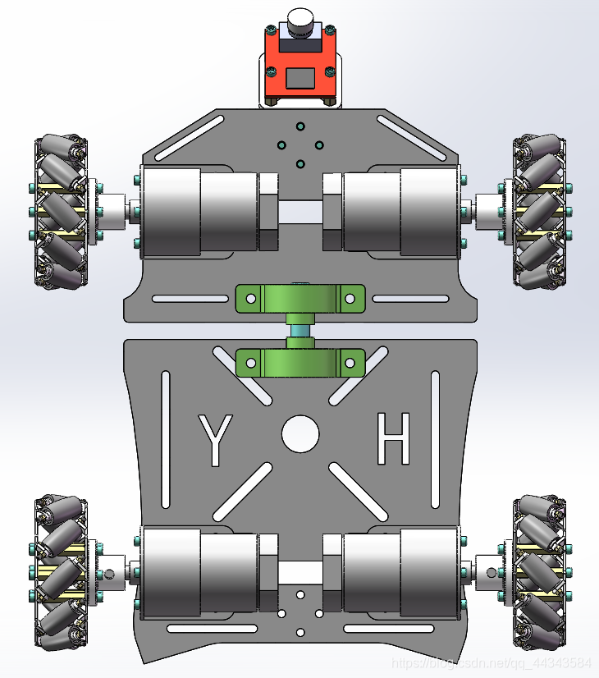
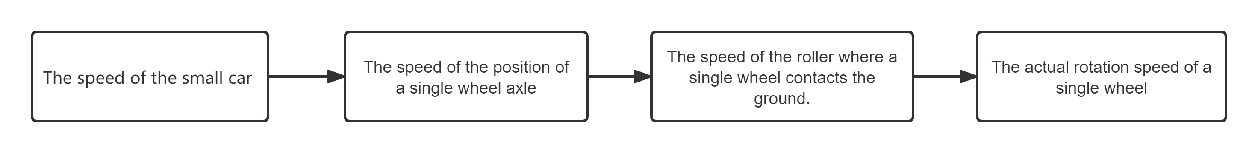
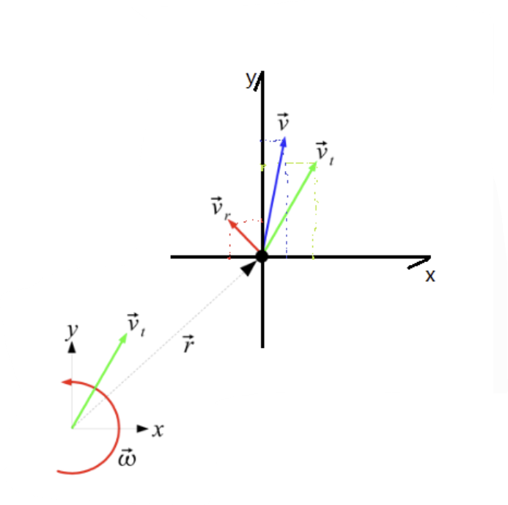
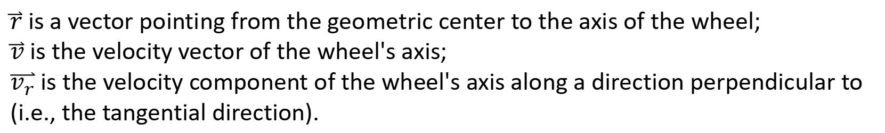
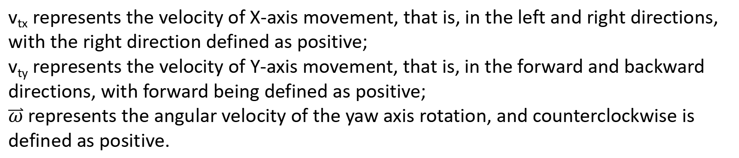
Construct an inverse kinematics model
v_{tx} represents the velocity of X-axis movement, that is, in the left and right directions, with the right direction defined as positive;
v_{ty} represents the velocity of Y-axis movement, that is, in the forward and backward directions, with forward being defined as positive;
$\overset{⃑}{ω}$represents the angular velocity of the yaw axis rotation, and counterclockwise is defined as positive.
$\overset{⃑}{r}$ is a vector pointing from the geometric center to the axis of the wheel;
$\overset{⃑}{v}$ is the velocity vector of the wheel's axis;
$\overset{⃑}{v_{r}}$ is the velocity component of the wheel's axis along a direction perpendicular to (i.e., the tangential direction).

Slide 5
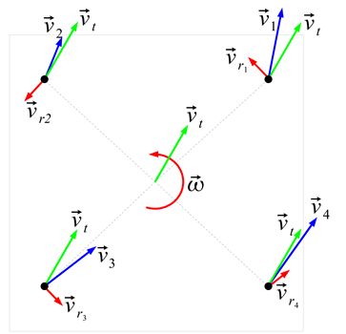
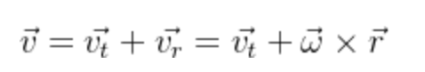

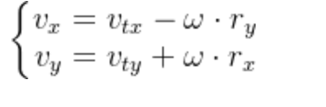
Construct an inverse kinematics model

Slide 6
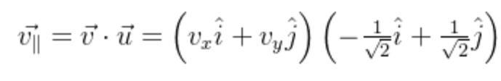
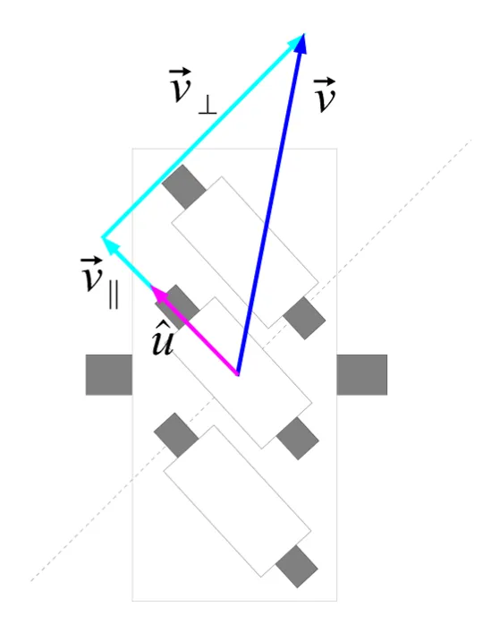
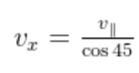
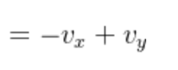


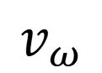
Construct an inverse kinematics model
$$= − \frac{1}{\sqrt{2}} v_{x} +\frac{1}{\sqrt{2}} v_{y}$$
Wheel speed ：
$$v_{ω}$$

Slide 7
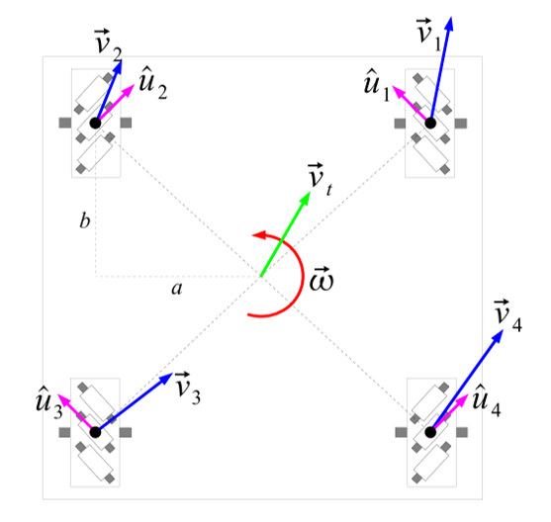
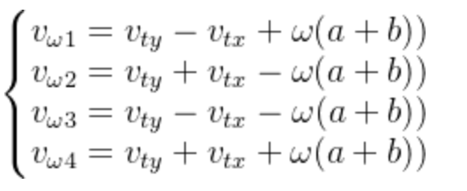
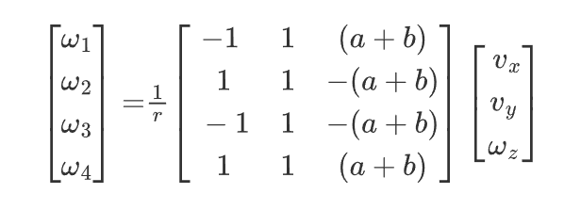
Construct an inverse kinematics model
②
①
③
④

Slide 8
02
Control Wheel by a Joystick

Slide 9
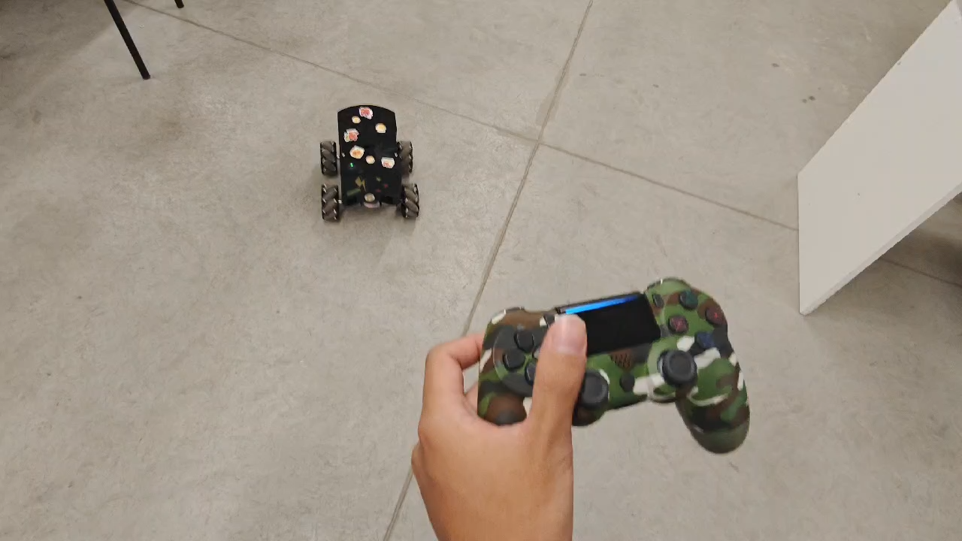

Slide 10
Calculate the motion of each axis
if event.type == pygame.JOYBUTTONDOWN:
print(f"按钮按下: {event.button}")
if event.button ==10 : # R2 减少角速度
multiple_angular_speed -= 0.1
multiple_angular_speed = max(0.2, multiple_angular_speed) # 最小值为0.2
print("**************max angular speed --")
print(multiple_angular_speed)
if event.button == 9: # R2 减少角速度
multiple_linear_speed -= 0.1
multiple_linear_speed = max(0.2, multiple_linear_speed) # 最小值为0.2
print("**************max angular speed --")
print(multiple_linear_speed)
if event.button ==0 : # R2 减少角速度
linear_speedx = 0
linear_speedy = 0
angular_speed = 0
If event.axis == 3: # 前后移动
if abs(event.value) < deadzone: # 忽略微小移动
linear_speedy = 0
else:
linear_speedy = -event.value * multiple_linear_speed
print(linear_speedy)
elif event.axis == 0: # 旋转
if abs(event.value) < deadzone: # 忽略微小移动
angular_speed = 0
else:
angular_speed = -event.value * multiple_angular_speed
print(angular_speed)
flag = 1

Slide 11
Calculate the angular velocity on the wheel
w_1 = (-linear_speedx + linear_speedy + (x_a + x_b) * angular_speed)*10
w_1 = round(w_1)
w_2 = (linear_speedx + linear_speedy - (x_a + x_b) * angular_speed)*10
w_2 = round(w_2)
w_3 = (-linear_speedx + linear_speedy - (x_a + x_b) * angular_speed)*10
w_3 = round(w_3)
w_4 = (linear_speedx + linear_speedy + (x_a + x_b) * angular_speed)*10
w_4 = round(w_4)

Slide 12
communication
hostname = socket.gethostname()
ip = socket.gethostbyname(hostname)
print(f"本机 IP: {ip}")
print(f"主机名: {hostname}")
UDP_IP = "192.168.88.231"
UDP_PORT = 6006
sock = socket.socket(socket.AF_INET,
socket.SOCK_DGRAM)
if(flag):
data = struct.pack('<4h',w_1,w_2,w_3,w_4)
print("data:")
print(data)
sock.sendto(data,(UDP_IP,UDP_PORT))

Slide 13
Navigation to target goal
03

Slide 14
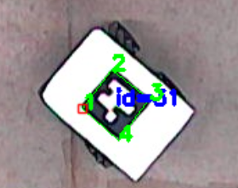
1、detect aruco tags
def detect_aruco_markers(frame):
gray = cv2.cvtColor(frame, cv2.COLOR_BGR2GRAY)
aruco_dict = cv2.aruco.getPredefinedDictionary(cv2.aruco.DICT_4X4_50)
detector = cv2.aruco.ArucoDetector(aruco_dict, cv2.aruco.DetectorParameters())
corners, ids, _ = detector.detectMarkers(gray)
if ids is not None:
for i in range(len(ids)):
if ids[i][0] == 31: # 只检测ID=31的标记
marker_corners = corners[i][0]
center_x = int(np.mean(marker_corners[:, 0]))
center_y = int(np.mean(marker_corners[:, 1]))
# 绘制标记和中心点
cv2.aruco.drawDetectedMarkers(frame, corners, ids)
cv2.circle(frame, (center_x, center_y), 5, (0, 0, 255), -1)
# 返回中心点和四个角点
return (center_x, center_y), marker_corners, frame
return None, None, frame

Slide 15
def calculate_control(current_pos, marker_corners):
global global_v, global_a, global_angle, global_distance,global_angular_speed,global_linear_speedy
# 计算中心点到目标点的距离
dx = target_point[0] - current_pos[0]
dy = target_point[1] - current_pos[1]
distance = math.sqrt(dx**2 + dy**2)
# 计算两条线的夹角线1：角点1到角点4的直线（标记的长边）线2：中心点到目标点的直线
angle = calculate_angle_between_lines(
marker_corners[0], marker_corners[3], # 角点1和角点4
current_pos, target_point # 中心点和目标点
)
# 调整角度范围为-180到180度（用于转向控制）需要确定转向方向（顺时针/逆时针）
cross_product = np.cross(
np.array(marker_corners[3]) - np.array(marker_corners[0]),
np.array(target_point) - np.array(current_pos))
# 如果叉积为负，角度取负
if cross_product < 0:
angle = -angle
linear_speedy = 0
if angle>2 :
angular_speed = 30
else:
angular_speed = 0
linear_speedy = 20 # 前进速度
global_angle = angle
global_distance = distance
global_linear_speedy = linear_speedy
global_angular_speed = angular_speed
w1, w2, w3, w4 = calculate_wheel_speeds(linear_speedy, angular_speed)
return distance, w1, w2, w3, w4
2.
calculate
distance
and
degree

Slide 16
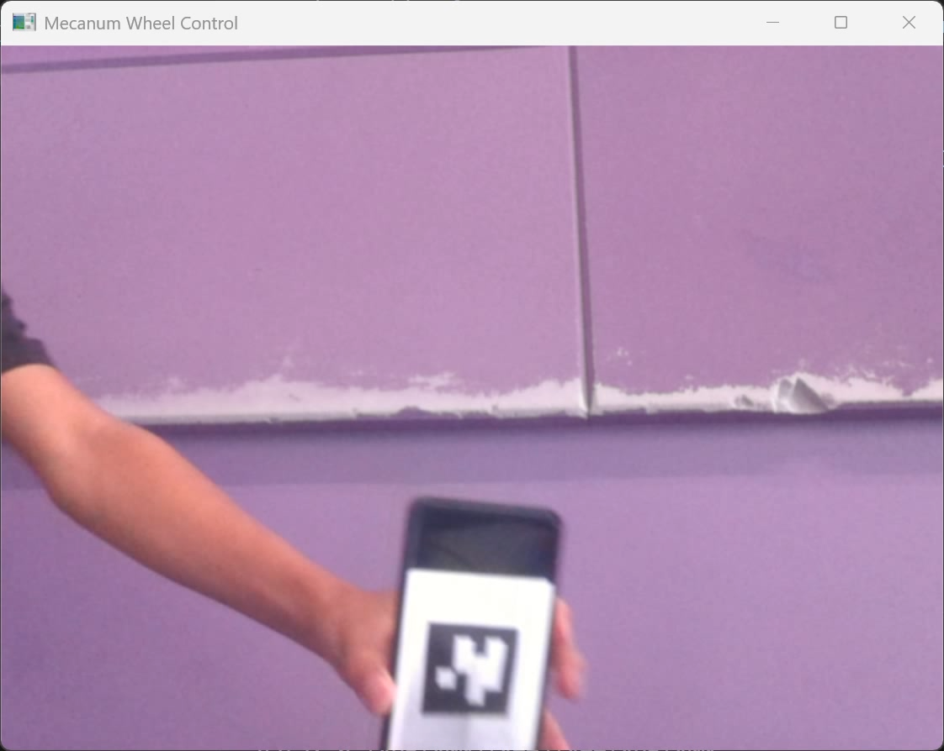
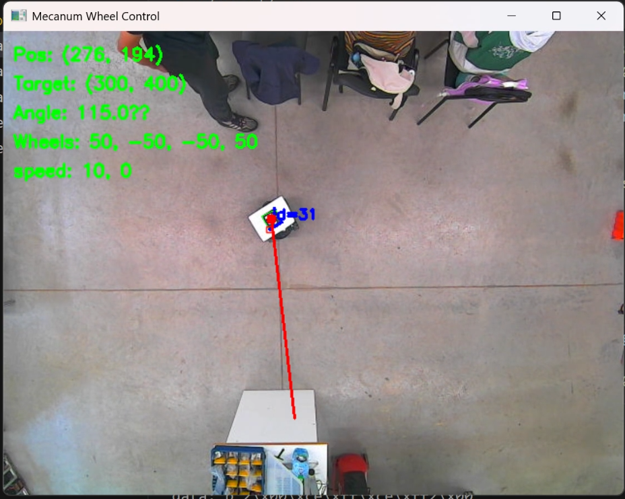

Slide 17
What we will do
1.Run our program in linux on ROS(maybe change a camera)
2. Make the loop statement logic clearer
3.Using PID to control our robot better

Slide 18
THANKS FOR WATCHING

